Slide 1
Early Detection of Breast Cancer

Slide 2
Introduction to Breast Cancer
01
03
05
Data Source and Description
Methodology and Techniques
Results and Discussion
02
04
06
Product Introduction
Product Experience
Product Price

Slide 3
Introduction to Breast Cancer
01

Slide 4



The Importance of Early Detection
01
02
03
Global Impact of Breast Cancer
Challenges in Diagnosis
Project Overview
Breast cancer is a leading cause of cancer-related deaths worldwide; therefore, early detection significantly improves treatment outcomes and survival rates.
Accurate and timely diagnosis remains challenging due to the complexity of breast cancer and the variability in tumor characteristics.
This project aims to develop a highly accurate and interpretable model for early breast cancer diagnosis using machine learning techniques.

Slide 5
Project Goals and Objectives
01
02
03
Main Objective
Key Performance Indicators
Deliverables
To build a reliable classification model that can differentiate between benign and malignant breast tumors with high precision.
Achieving high accuracy, sensitivity, and specificity to minimize diagnostic errors and improve patient care.
A robust data mining pipeline, a well-trained classification model, and an interpretability report explaining the model's predictions.

Slide 6
Data Source and Description
02

Slide 7
The Wisconsin Diagnostic Dataset
01
03
02
Dataset Origin
Dataset Characteristics
The Wisconsin Diagnostic Breast Cancer (WDBC) dataset from the UCI Machine Learning Repository is used in the project as it contains digitized images of breast mass.
Feature Overview
The dataset consists of numerical features, suitable for various data mining and machine learning algorithms.
The dataset includes features computed from fine needle aspirate (FNA) images, such as radius, texture, concavity, and other cellular characteristics.

Slide 8
Data Preprocessing and Cleaning
Feature Scaling
Handling Missing Values
Scaling numerical features using standardization or normalization to prevent bias due to differing scales.
Addressing missing values using appropriate imputation techniques to ensure data completeness and model accuracy.
Data Splitting
Dividing the dataset into training, validation, and testing sets to properly train and evaluate the model.

Slide 9
Methodology and Techniques
03

Slide 10
Exploratory Data Analysis (EDA)
03
Data Visualization
01
Outlier Detection
Using histograms, scatter plots, and box plots to understand the distribution and relationships among features.
Detecting and handling outliers that may negatively impact model performance.
02
Feature Correlation
Identifying highly correlated features to avoid multicollinearity issues in the model.

Slide 11
Model Selection and Training
01
02
03
Baseline Models
Hyperparameter Tuning
Cross-Validation
Comparing various classification algorithms, including Logistic Regression, SVM, Random Forest, and Gradient Boosting, as baselines.
Optimizing model parameters using GridSearchCV to maximize performance on the validation set.
Employing cross-validation techniques to ensure robust model evaluation and prevent overfitting.

Slide 12
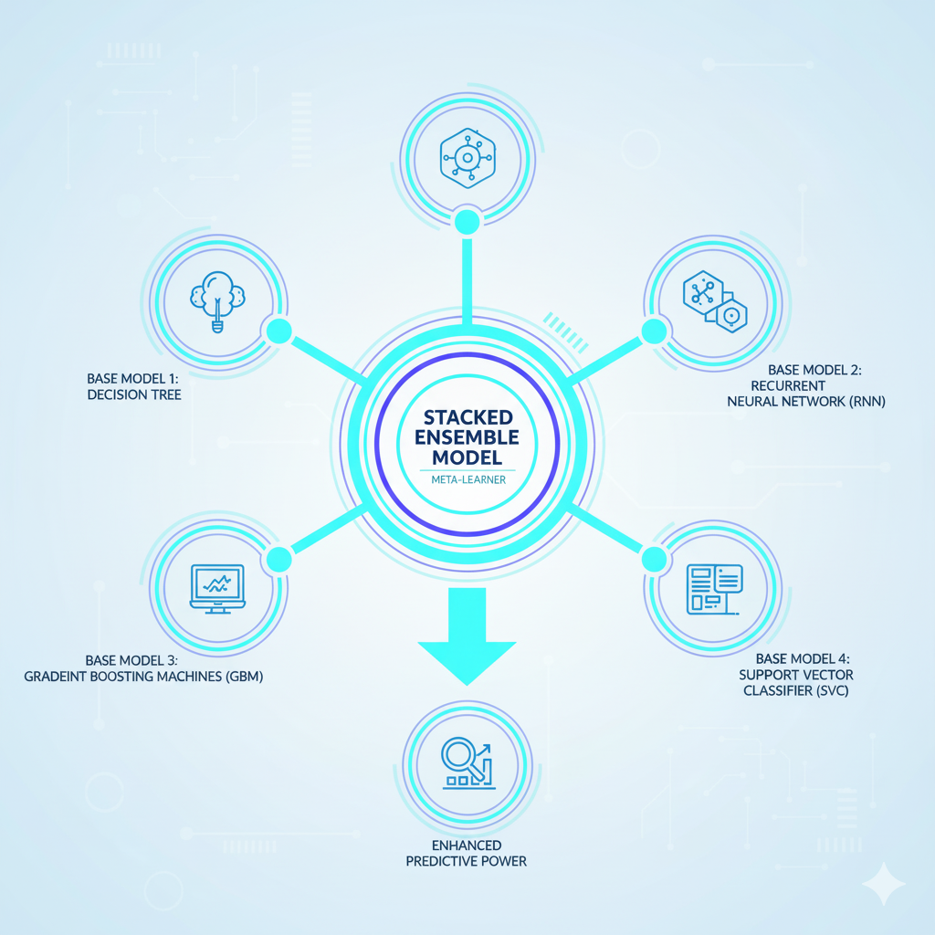
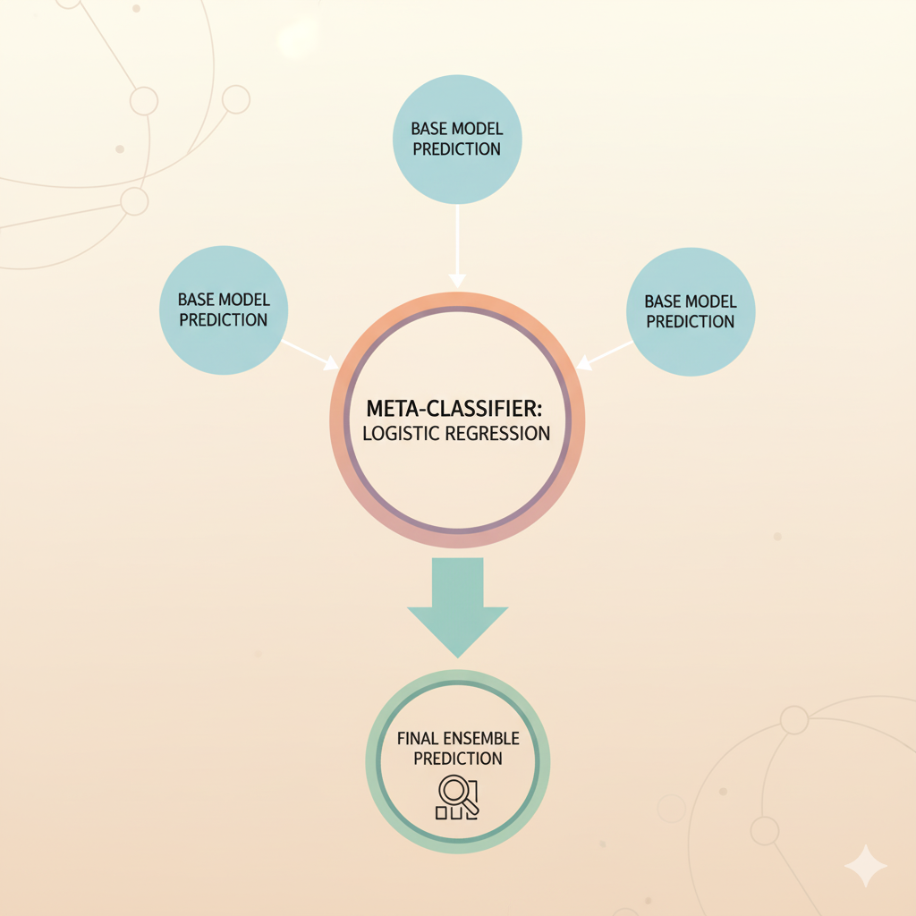
Ensemble Modeling
Stacked Ensemble
Meta-Classifier
Developing a stacked ensemble model that combines multiple diverse base models for enhanced predictive power.
Using a meta-classifier (e.g., Logistic Regression) to learn the optimal weighting of base model predictions.

Slide 13
Model Evaluation and Performance Metrics
04

Slide 14
Evaluation Metrics
01
02
03
Accuracy
Precision and Recall
F1-Score
Measuring the overall correctness of the model's predictions.
Assessing the model's ability to correctly identify malignant tumors while minimizing false positives and false negatives.
Harmonic mean of precision and recall, providing a balanced measure of the model's performance.

Slide 15
Confusion Matrix
True Positives (TP)
False Positives (FP)
Correctly identified malignant cases, crucial for effective diagnosis.
Incorrectly classified benign cases as malignant, leading to potential overtreatment.
True Negatives (TN)
False Negatives (FN)
Correctly identified benign cases, reducing unnecessary interventions.
Incorrectly classified malignant cases as benign, posing significant health risks due to delayed treatment.

Slide 16
Interpretability and Explanation
05

Slide 17
SHAP Analysis
SHAP Values
01
Using SHAP (SHapley Additive exPlanations) to quantify the contribution of each feature to the model's predictions.
02
Visualizations
Creating SHAP summary plots to visualize the impact of features on model output, aiding doctors in decision making.
Feature Importance
03
Identifying the most influential cellular features (e.g., "worst concave points," "mean texture") in breast cancer diagnosis.

Slide 18
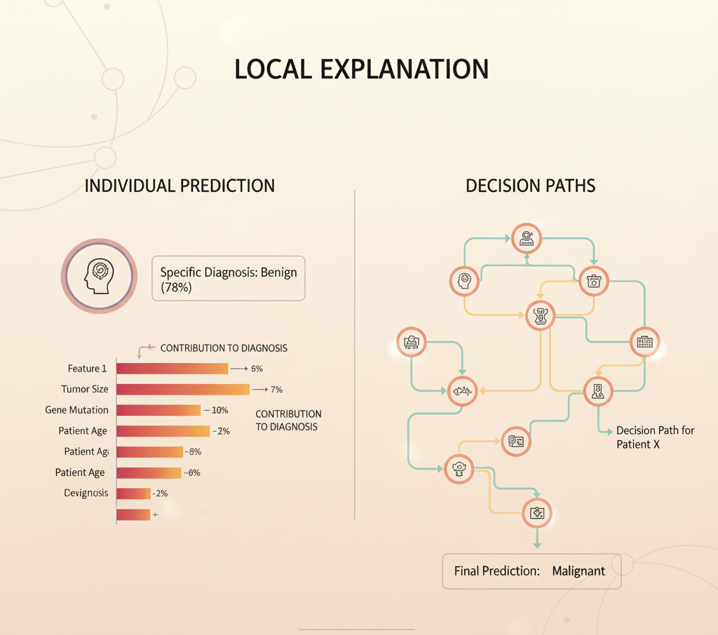
Local Explanations
Individual Predictions
Providing explanations for individual predictions, showing how each feature contributed to specific diagnoses.
Decision Paths
Visualizing the decision paths of individual instances through the model, enhancing transparency and trust.

Slide 19
Results and Discussion
06

Slide 20
Model Performance Summary
01
Precision, Recall, and F1-Score
Detailing the precision, recall, and F1-score to provide a comprehensive evaluation of the model's capabilities.
Accuracy Results
02
Presenting the accuracy achieved by the best-performing model on the test dataset.
03
Comparative Analysis
Comparing the performance of different models to highlight the advantages of the ensemble approach.

Slide 21

Key Findings
01
Important Features
Discussing the most significant features identified by the SHAP analysis and their clinical relevance.
02
Model Interpretability
Highlighting the importance of interpretability in medical applications for building trust and understanding.

Slide 22
Conclusion and Future Work
07

Slide 23


Conclusion
Significance
01
Reiterating the importance of early detection and the role of machine learning in improving diagnostic accuracy.
Project Achievements
Summarizing the key accomplishments of the project and the potential impact on early breast cancer diagnosis.
02

Slide 24
Future Work
Enhanced Data
The collection of more various data for enhanced accuracy in diverse populations.
Integration of other Techniques
Clinical Validation
Exploring incorporating other machine learning models and deep learning techniques that may provide better performance.
Performing clinical validation studies to assess the real-world effectiveness of the model and its potential for integration into clinical workflows.

Slide 25
Thank you for watching.

